Slide 1
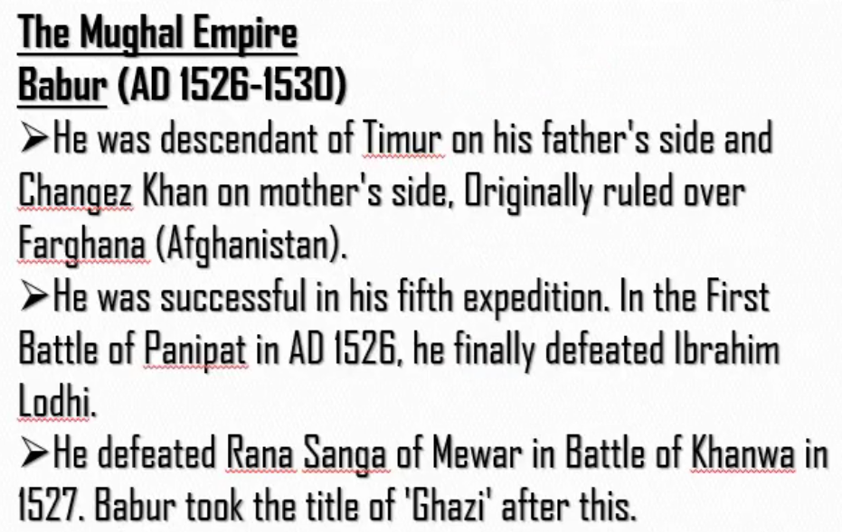
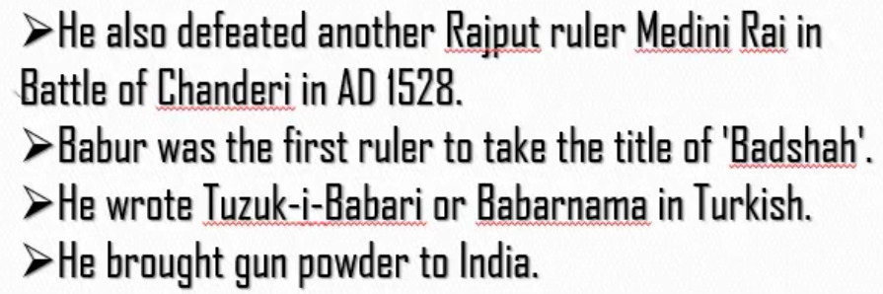
BHAJSA B
B – Babar H – Humayun A – Akbar J – Jahangir S – Shah Jahan A – Aurangzeb B – Badushah Zafar
Changez Khan also known as Gengiz Khan.
Babar used canon weapons which were very powerful. So he won against powerful rulers such as Ibrahim Lodhi and Rana Sanga.

Slide 2
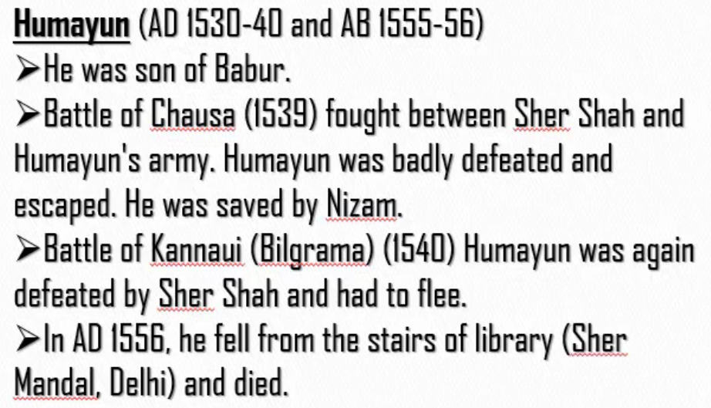
In 1539, Humayun was defeated by Sher Shah for the first time. Sher Shah was about to kill Humayun. But Nizam saved him and helped him to save his kingdom.
In 1540, Humayun was again defeated by Sher Shah. This time Nizam didn’t help him. So he fleed (escaped) (ran away by living his kingdom)
In 1555, he was able to get back the kingdom again in his hands. Unfortunately, he died in 1556.
In third point it is not “Battle of Kannaui”. It is “Battle of Kannauj” which is also known as “Battle of Bilgrama.”

Slide 3
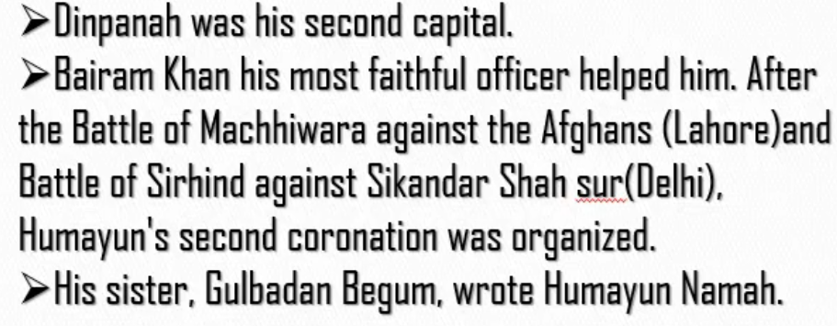
How did Humayun became king for the second time?
Afghans – Sur dynasty.
Second Corornation – Second time became king.
After becoming king for second time, he made Dinpanah as his capital.

Slide 4
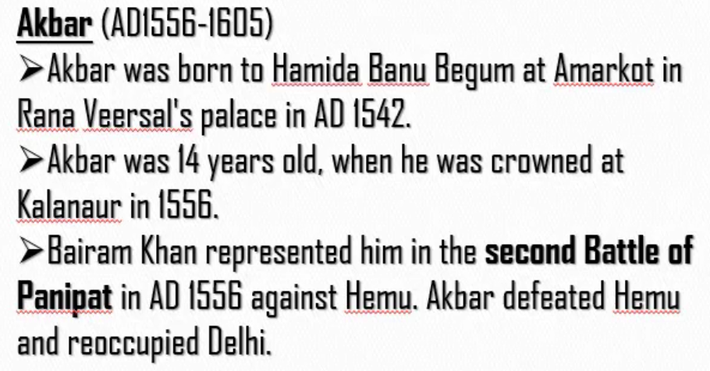
Hamida Banu Begum was the wife of Humayun. Rana Veersal was father of Hamida Banu.
Humayun died in 1556. So Akbar was crowned in 1556.
Bairam Khan – He is the same officer who helped Humayun to become king for the second time.
Hemu considered Akbar as a week ruler and so captured Delhi.
The same Bairam Khan fought the battle in place of Akbar with Hemu. He won that battle. So, it is said that

Slide 5
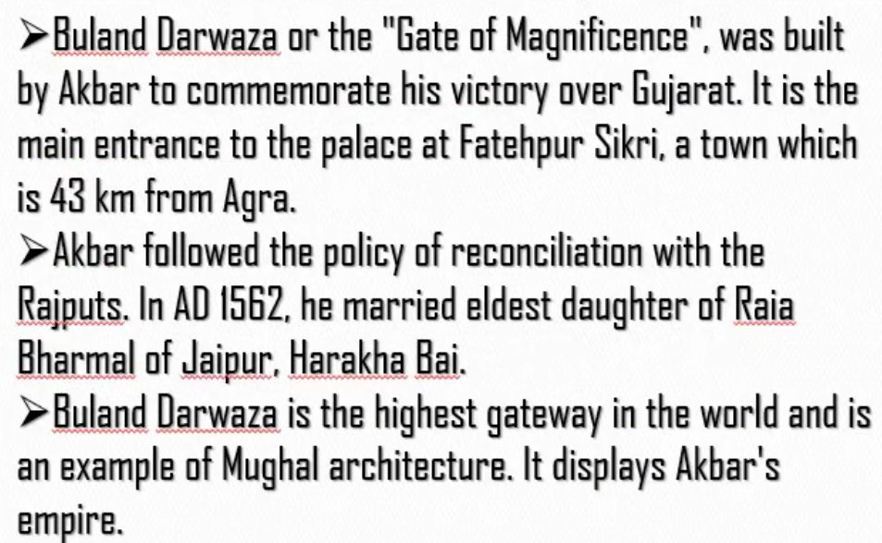
Babar defeated Rajputs and occupied their kingdom. So Rajputs were very much angry against Mughals. Akbar who was so humble followed the policy of reconcilation (raji). He made raji with Rajputs by marrying one of the above mentioned elder daughter of Rajputs.

Slide 6
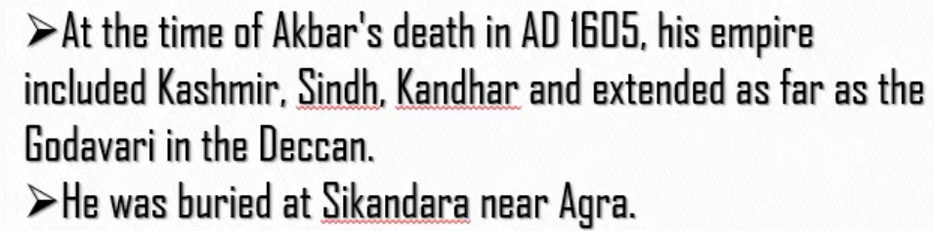
A point which is not there in the slide, but important for exam:
Akbar was very much liberal in terms of religion. He gave freedom to people in his kingdom to follow the religion which they liked.
He himself established own religion known as “Din-e-Ilahi”. Mahesh (also known as Beerbal) was the only Hindu follower of that religion.

Slide 7
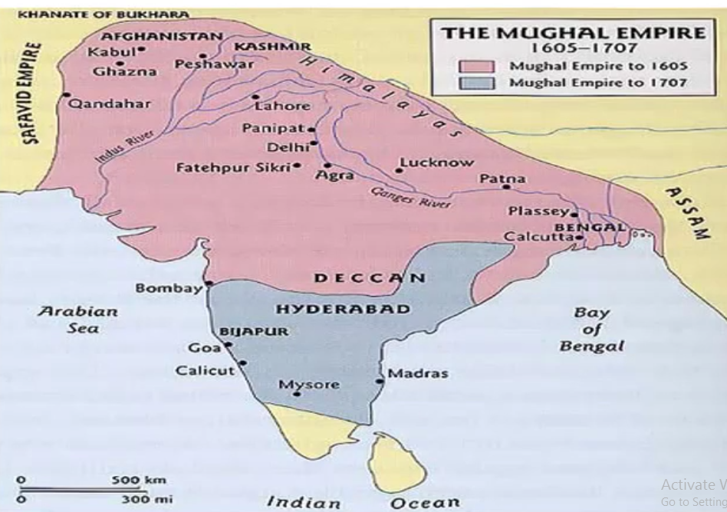
Akbar died in 1605. (Mughal Empire till then shown in Rose colour)
Aurangzeb died in 1707. (Mughal Empire till then shown in Blue colour)
Rulers after Akbhar is discussed in Mughals – II

